Slide 1


NS
LECTURE
Palo Alto Firewall -
Content Identification (Content ID)
Network Security
Diploma in CSF
Year 3 (2020/21), Semester 5
5
Notes:
Left-hand Bar – Replace FSP by your module code and X by the lecture number.
Replace Lecture Title
Replace < Module Name >
Replace Year and Semester if necessary

Slide 2
Agenda
Security Profiles
Anti-Virus
Anti-Spyware
Vulnerability
URL Filtering
File Blocking
Security Profile Administration
Zone Protection Profile

Slide 3
Flow Logic
Initial Packet Processing
Source Zone/ Address/ User-ID
Security Pre Policy
Check Allowed Ports
Application
Check for Encrypted Traffic
PBF/ Forwarding Lookup
NAT Policy
Evaluated
Decryption Policy
Security Policy
Post Policy Processing
Session Created
Application Override Policy
App ID
Check Security Policy
Check Security Profiles
Re-Encrypt Traffic
Packet Forwarded
NAT Policy Applied
Destination Zone
Notes:
In order to provide the most robust network security model possible, the Palo Alto Networks firewall allows granular control over network traffic. Beyond simply allowing or denying traffic based on source, destination, and port information, the device can examine allowed traffic for specific threats. including viruses and spyware. Additionally, traffic can be scanned for prohibited action, such as the distribution of sensitive data.

Slide 4
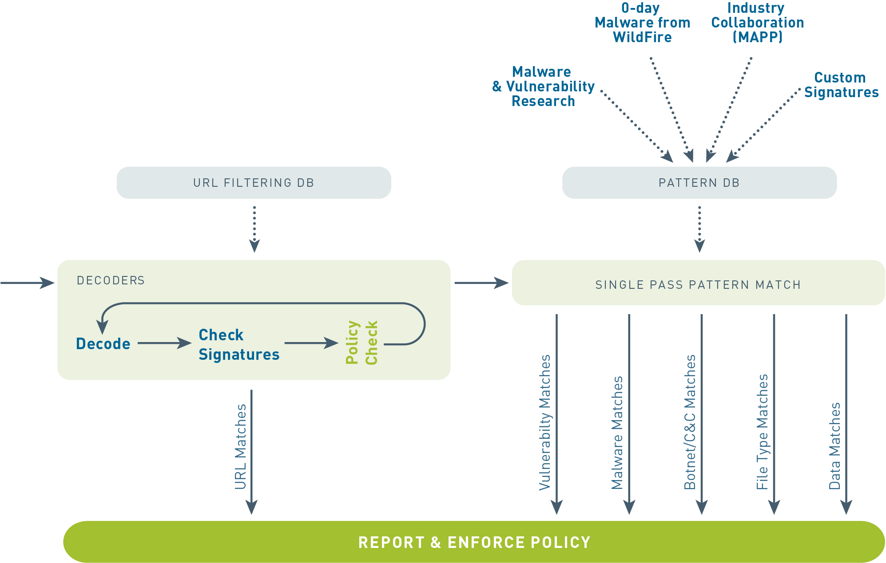
Content-ID
A stream-based, not file-based, architecture for real-time performance
Notes:
Content-ID combines a real-time threat prevention engine with a comprehensive URL database and elements of application identification to limit unauthorized data and file transfers, detect and block a wide range of threats and control non-work related web surfing.
Advantages of Content-ID include:
A stream-based, not file-based, architecture for real-time performance
The ability to block transfer of sensitive data and file transfers by type
URL filtering capability enabled via a fully-integrated URL Database
The ability to detect zero-day attacks with Wildfire
For additional reading about threat prevention in PAN-OS, refer to the Threat Prevention Deployment Tech Note available on the support website.

Slide 5
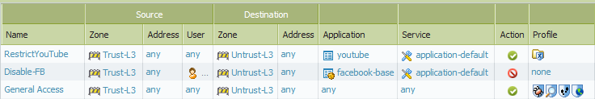

Security Profiles
Policies > Security
Antivirus
Vulnerability
Anti-Spyware
URL Filtering
File Blocking
Data Filtering
Policy Group
Notes:
Security profiles are objects that are added to security policies with the allow action. Profiles are not necessary for security policies with the deny action, since no further processing is needed if the packet is to be dropped. As with policies, profiles are applied to all packets over the life of a session.
The profiles represent additional security checks to be performed on the allowed traffic. They look for improper or malicious use of applications that are allowed in the environment. For example, web browsing may be allowed, but you still worry that users could download a virus from a website. The security policy would allow web browsing and an anti-virus profile would be added in order to detect and react to viruses.
Types of security profiles include:
Antivirus: Detects infected files being transferred with the application.
Anti-Spyware: Detects spyware downloads and traffic from already installed spyware.
Vulnerability Protection: Detects attempts to exploit known software vulnerabilities.
URL Filtering: Classifies and controls web browsing based on content.
File Blocking: Tracks and blocks file uploads and downloads based upon file type and application.
Data Filtering: Looks for specific patterns of data in the traffic.

Slide 6
Security Profiles: Anti-Virus

Slide 7
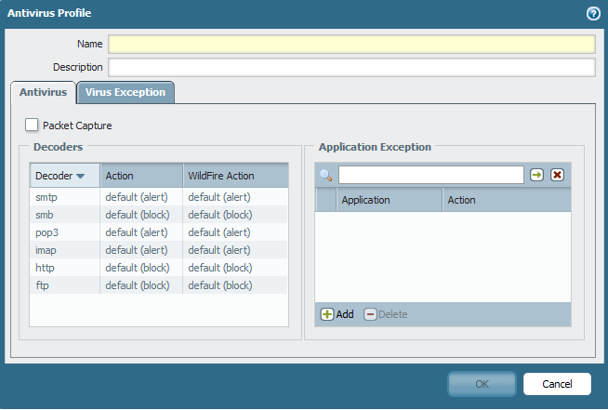
Anti-Virus Security Profile
Objects > Security Profiles > Antivirus
Identifies applications exempted from this rule
Notes:
The Anti-Virus profile defines actions to be taken if an infected files is detected as part of an application exchange. The listed applications represent the wide variety of vectors that modern viruses can take in infecting a system. For each application type an action can be defined. The default action is to block any detected virus unless the protocol is POP3, IMAP or SMTP, then the default action is to alert. These three protocols are store-and-forward protocols: if an intermediate device drops the packets, SNMP/POP3/IMAP are designed to continually resend until the data is ultimately delivered. For these kinds of applications the infected file needs to be removed at either the server or the client, not on the wire.
The Actions column configures the action taken if the infected file is identified by the firewall anti-virus definitions file. The WildFire Action column defines the action taken if the infected file is matched against the threat list maintained by the WildFire subscription feature, which is discussed later in this module.
If you configure the action to alert, no traffic will be blocked. The only action taken will be to generate an entry in the threat log. By selecting the Packet Capture check box, any alert will also be accompanied by a packet capture of the portion of the file that triggered the virus signature. This can be use to verify the presence of the virus and rule out false positives.
SMB – Server Message Block protocol (uses port 137, 138, 139 or 445)

Slide 8
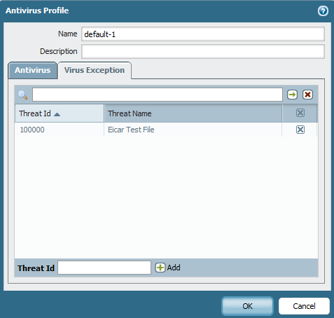
Anti-Virus Exceptions
Objects > Security Profiles > Antivirus
Notes:
The administrator can configure anti-virus profiles reduce false positive results or to ignore log messages irrelevant to the particular network.
To create an exception, search the threat log for the threat ID that you wish to exclude. Add the threat ID to the Virus Exception tab. In the example above, this profile will not alert or block the Eicar test virus file.

Slide 9
Security Profiles: Anti-Spyware

Slide 10
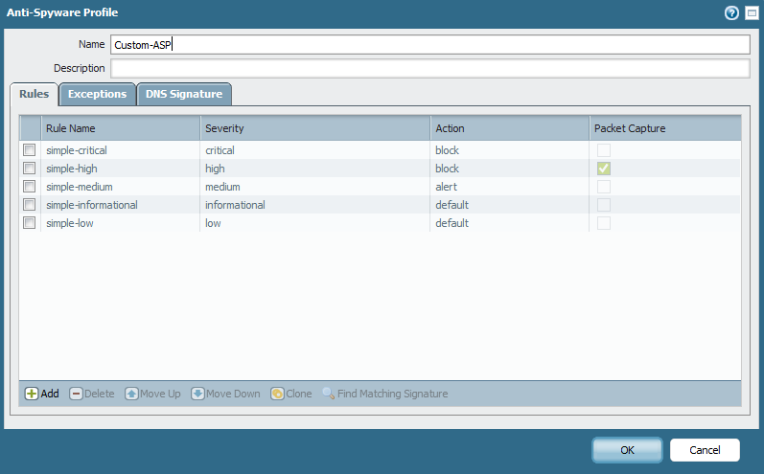
Anti-Spyware Security Profile
Objects > Security Profiles > Anti-spyware
Notes:
A security policy can include specification of an anti-spyware profile for “phone home” detection (detection of traffic from installed spyware).
The firewall includes two pre-defined anti-spyware security profiles:
Default: The profile applies the default action to all client and server critical, high, and medium severity spyware events. This profile is typically used for proof of concept (POC) or first phase deployments.
Strict: The profile applies the block response to all client and server critical, high and medium severity spyware events and uses the default action for low and informational spyware events. Strict profiles are used for out of the box protection with recommended block of critical, high, and medium threats.
The pre-defined profiles cannot be modified or deleted.
Customized profiles can be used to minimize anti-spyware inspection for traffic between trusted security zones, and to maximize the inspection of traffic received from untrusted zones, such as the Internet, as well as the traffic sent to highly sensitive destinations, such as server farms.

Slide 11
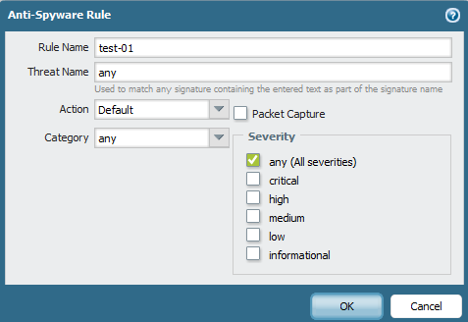
Anti-Spyware Threat Types
Default
Allow
Alert
Block
Objects > Security Profiles > Anti-Spyware
Any
Adware
Backdoor
Botnet
Browser-hijack
Data-theft
Keylogger
Net-worm
p2p-communication
Spyware
Notes:
Each Anti-Spyware security profile can contain multiple rules to handle different types of threats.
Each rule is configured with an action, a specific category of spyware to target, and severity levels.
Rules with different actions can be combined in the same profile.

Slide 12
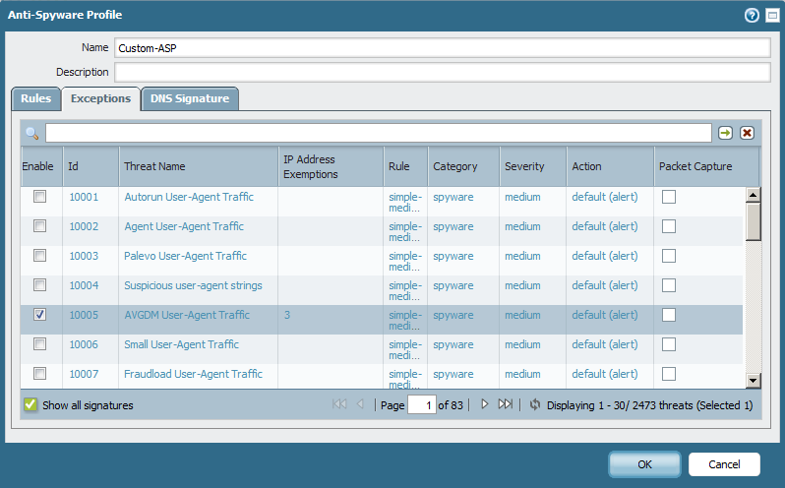
Anti-Spyware Exceptions
Objects > Security Profiles > Anti-spyware
Notes:
The Exceptions tab allows you to change the response to a specific signature. For example, the profile can be set to block all packets matching anti-spyware signatures, but alert for user selected ones.
Exceptions are made for individual signatures and can be restricted to specific IP addresses. IP addresses must be entered as unicast addresses. The IP Address Exception column only lists the number of address entered. Click the number in the column to see the actual IP addresses. Addresses specified will be checked against both the source and destination addresses.
Packet captures, if desired, must be requested on a per-signature basis. The packet captures can be set for both active and exempted signatures.

Slide 13
Security Profiles: Vulnerability
(Optional – Slides 14 to 16)
Notes:
Detecting DNS queries for known malware domains is a very effective tool for detecting compromised hosts. The DNS Signatures settings provides an additional method of identifying infected hosts on a network. These signatures detect specific DNS lookups for host names that have been associated with malware. The DNS signatures can be configured to allow, alert, or (default) block when these queries are observed, just as with regular antivirus signatures. Additionally, hosts that perform DNS queries for malware domains will appear in the botnet report. DNS signatures are downloaded as part of the antivirus updates. DNS-based botnet signatures are included with the daily antivirus updates, as part of the Threat Prevention subscription.
Note: DNS-based botnet signature scanning only works if the DNS requests are visible to the firewall.

Slide 14
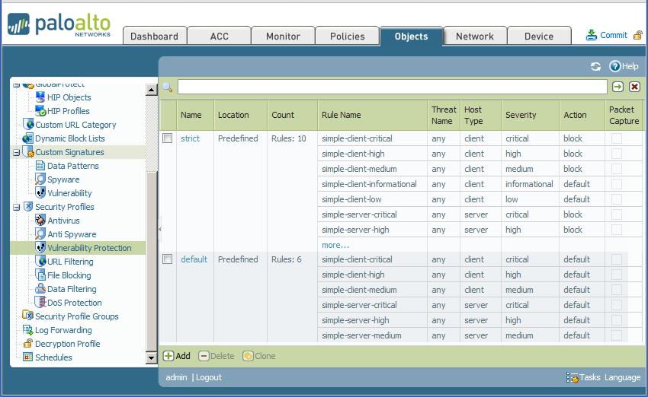
Vulnerability Protection Security Profile
Objects > Security Profiles > Vulnerability Protection
Notes:
A security policy can include specification of a vulnerability protection profile that determines the level of protection against buffer overflows, illegal code execution, and other attempts to exploit system vulnerabilities. The firewall includes two pre-defined vulnerability protection security profiles:
Default: The profile applies the default action to all client and server critical, high, and medium severity vulnerability protection events. This profile is typically used for proof of concept (POC) or first phase deployments.
Strict: The profile applies the block response to all client and server critical, high and medium severity vulnerability protection events and uses the default action for low and informational vulnerability protection events. Strict profiles are used for out of the box protection with recommended block of critical, high, and medium threats.
The pre-defined profiles cannot be modified or deleted.

Slide 15
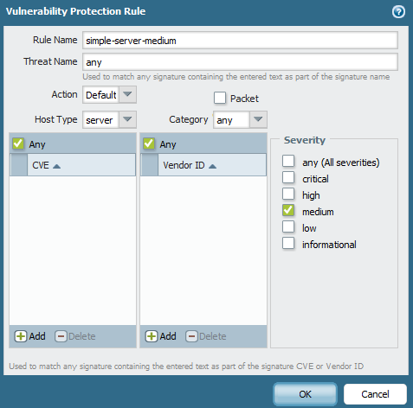
Creating a New Vulnerability Protection Profile
Creates Customized Security:
Focus on specific threats, CVEs, or vendors
Look for server, client, or combination threats
Tailor actions based on category and severity
Notes:
Customized profiles can be used to focus vulnerability checking for specific threats and types of traffic. Available actions for traffic which match a vulnerability protection profile are:
Allow: Threats are allowed to pass with no further actions.
Alert: Threats are allowed to pass and are logged in the threat log.
Block: Threats are blocked by the firewall and logged in the treat log.
Note: CVE stands for Common Vulnerabilities and Exposure, a system maintained by the MITRE corporation, which catalogs publicly known information security threats.

Slide 16
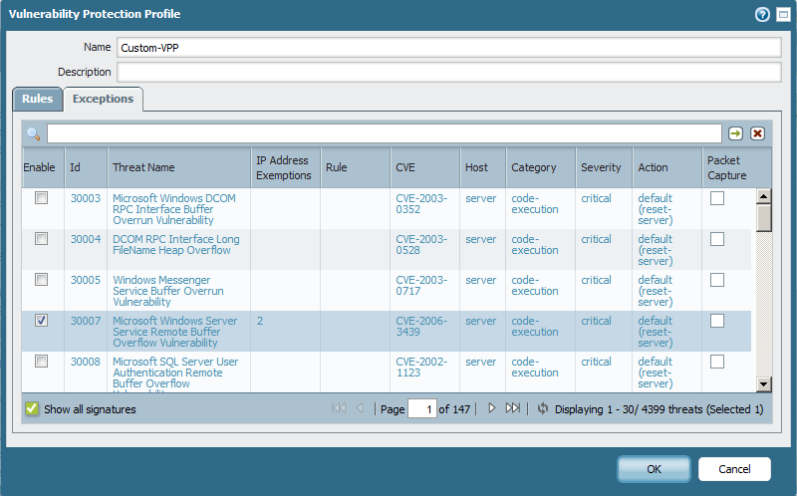
Vulnerability Exceptions
Objects > Security Profiles > Vulnerability Protection
Notes:
The Exceptions tab allows you to change the response to a specific signature. For example, the profile can be set to block all packets matching vulnerability signatures, but alert for user selected ones.
Exceptions are made for individual signatures and can be restricted to specific IP addresses. IP addresses must be entered as unicast addresses. The IP Address Exception column only lists the number of address entered. Click the number in the column to see the actual IP addresses. Addresses specified will be checked against both the source and destination addresses.
Packet captures, if desired, must be requested on a per-signature basis for exceptions.

Slide 17
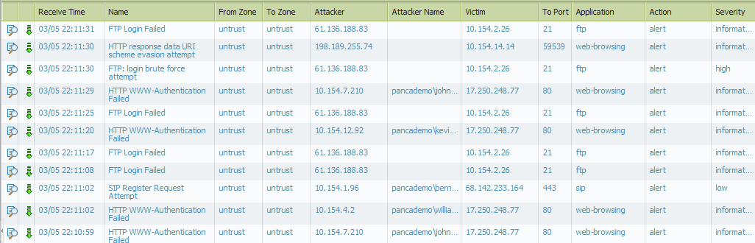
Threat Log
Anything logged from anti-virus, anti-spyware or vulnerability protection profiles are viewed in the Threat Log
Monitor > Logs > Threat
The green arrow represents a PCAP for the log entry
Notes:
The threat log records each security alarm generated by the firewall. Each entry includes the date and time, the threat type, such as a virus or spyware/vulnerability filtering violation, the source and destination zones, addresses, and ports, the application name, and the action and severity.
Threat log entries can be logged remotely by severity level by defining log forwarding profiles, and then assigning the profiles to security rules. Threats are logged remotely only for the traffic that matches the security rules where the logging profile is assigned.
Threat logs are used in generating reports and in the Application Command Center.

Slide 18
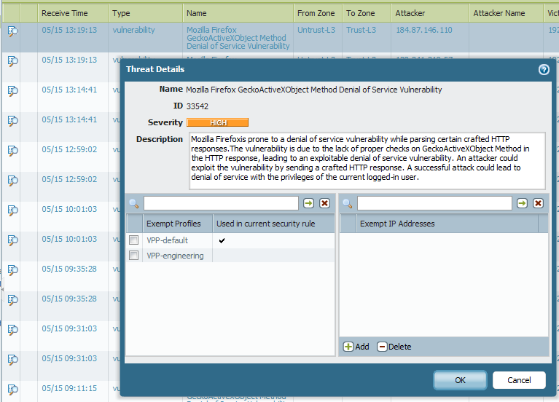
Creating an IP Exemption from the Threat Log
Click the threat name in the threat log to add IP exemptions to multiple profiles at once
Notes:
Often, the need for exceptions to the vulnerability and anti-spyware profiles are not known until a user complains that they have lost functionality. The situation is further complicated by the fact that multiple profiles may need to have the same exception defined.
Check the box next to the profiles that should have an exemption for this threat and, optionally, specify the IP address exemptions in the adjacent panel.
Note: The Threat Details interface is exclusively for adding functionality. The values shown do not reflect the current state of the listed profile exemption lists. You must check the individual profiles to verify whether or not an exemption already exists.

Slide 19
Security Profiles: URL Filtering

Slide 20
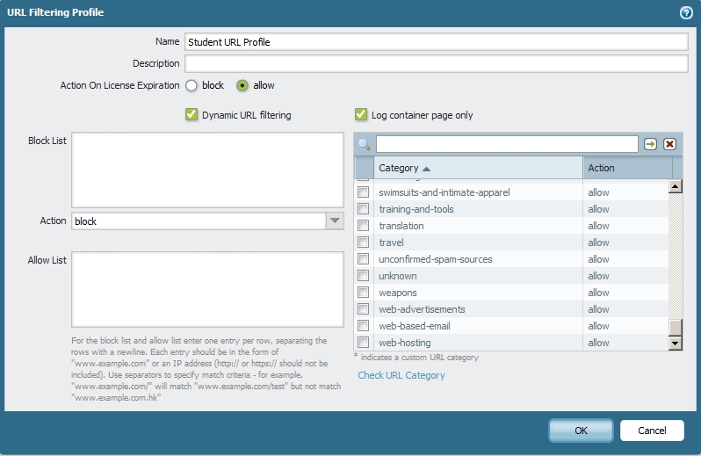
URL Filtering Security Profile
Objects > Security Profiles > URL Filtering > Add
Notes:
A security policy can include specification of a URL filtering profile that blocks access to specific web sites and web site categories, or generates an alert when the specified web sites are accessed (a URL filtering license is required). You can also define a block list of web sites that are always blocked (or generate alerts) and an allow list of web sites that are always allowed.
Pre-defined sets of web categories can be downloaded from Palo Alto Networks. PAN-OS supports two different URL filtering databases: BrightCloud and PAN-DB. These URL filtering technologies will be discussed later in the module.
Administrators can also define custom URL categories to customize the behavior of the URL filtering profiles.

Slide 21

URL Category vs. URL Filtering Security Profile
Policies > Security
URL Category | URL Filtering Security Profile
Used as a match condition in policies | Applied to traffic allowed by security policy
Only matches pre-defined or custom categories | Can matches pre-defined or custom categories, as well as block/allow lists
Action is determined by the policy | Action can be configured differently for individual categories or URLs
Logged as part of the entry for a policy in the traffic log | Logged in the URL Filtering log
Notes:
The URL Filtering feature can be used by placing categories directly in policies or attaching a URL Filtering profile to a security rule. URL filtering only affects HTTP and HTTPS traffic.
The URL Category field can be used as a match condition for security, QoS, decryption, and Captive Portal policies. Both pre-defined and custom categories can be matched when using the URL category field. The URL category itself does not have an associated action – traffic behavior is controlled by the policy.
The URL Filtering security profile provides granular control for traffic allowed by a security policy. As with other profiles, the URL filtering profile is only applied if the associated policy allows traffic. The profile can match URL categories, as well as individual URLs. Each category can be assigned a different action for more focused management. For example, a security policy could be created to allow all web browsing but have a policy which blocks all access to file sharing websites and logs all access to social networks.

Slide 22
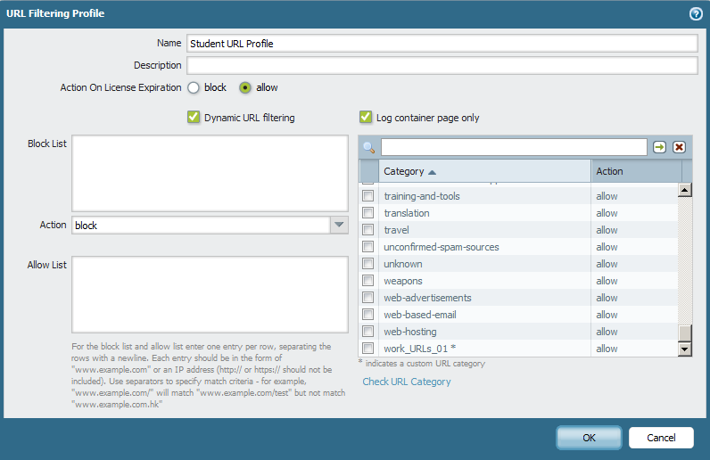
URL Filtering Sequence
When a Security Policy triggers a URL Profile, the URL is checked against:
Block List
Allow List
Custom Categories
URL Categories (PAN-DB or BrightCloud)
1
4
2
3
Notes:
Each URL Filtering profile can be configured with explicit Block and Allow lists, which take precedence over URL categories. You must omit the http[s]:// portion of the URLs when populating these lists. Entries in the block and allow lists are case-insensitive and must match exactly. For example, www.ebay.com is different from ebay.com.
Block lists, Allow lists, and Custom Categories support wildcard patterns. A token is a string of characters that begins or ends with a valid separator character (. / ? & = ; +). For example, the following patterns are valid:
*.yahoo.com (Tokens are: "*", "yahoo" and "com")
www.*.com (Tokens are: "www", "*" and "com")
www.yahoo.com/search=* (Tokens are: "www", "yahoo", "com", "search", "*")
It is recommended to enter the firewall administrator’s domain in the Allow List to avoid possible miscategorization.
For additional reading on this topic, refer to the document URL Categorization Components and Process on the support web site.

Slide 23
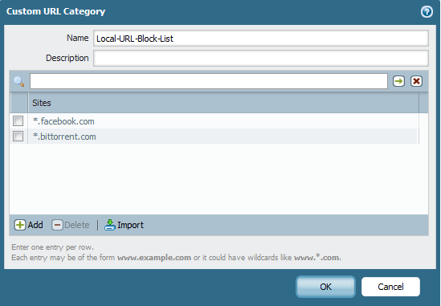
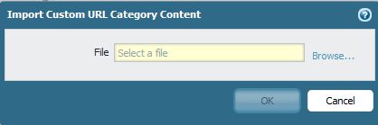
Custom URL Categories
Objects > Custom URL Categories
Will accept wildcards and IP addresses
Notes:
The custom URL categories feature allows you to create your own lists of URLs that can be selected in any URL filtering profile. Each custom category can be controlled independently and will have an action associated with it in each URL filtering profile (allow, block, continue, override, or alert).
URL entries can be added individually, or you can import a list of URLs. To do so, create a text file that contains the URLs to include, with one URL per line. Each URL can be in the format
www.example.com and can contain * as a wildcard, such as *.example.com.

Slide 24
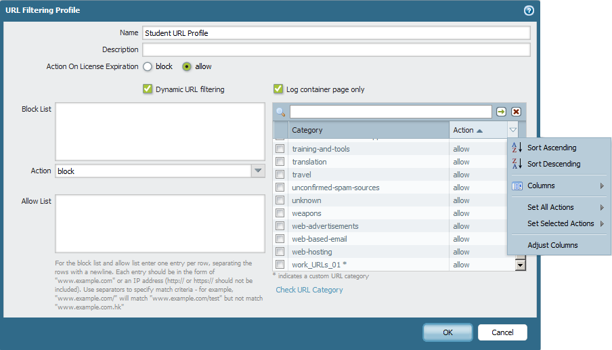

URL Filtering Actions
Change actions for all categories
Change action for an individual category
Notes:
Actions can be set for both the Block list and the URL categories. The available actions are:
Allow – Allow the user to access the website, no log or user message is generated
Block – Traffic is blocked, a Block log entry is generated, and a Response page is sent to the user’s browser
Alert – Allow the user to access the web site but add an alert to the URL log
Continue – Send a response page requiring the user to click Continue to proceed, log the action
Override – Send a response page and allow the user to access the blocked page after entering a password, log the action
If a user successfully Continues or Overrides, they will have access to the Category associated with the URL that generated the event for 15 min without having to Continue or Override again. This timeout time is configurable.
The override password is set in Device > Setup >Content ID > URL Admin Override. There can only be one URL Admin Override password per firewall.

Slide 25
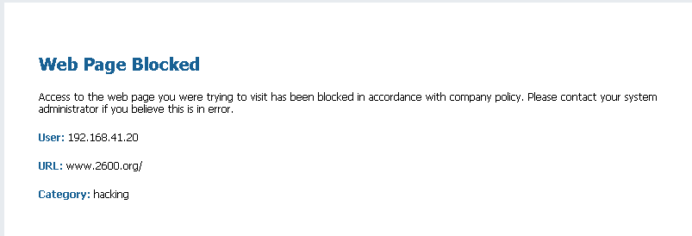
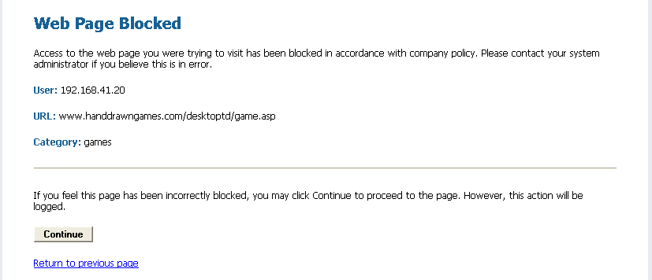
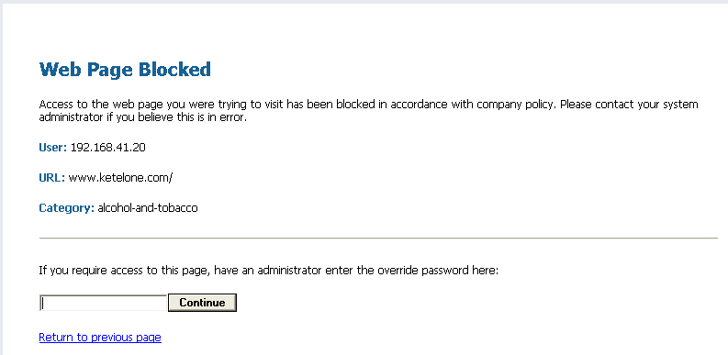
URL Filtering Response Pages
Device > Response Pages
Blocked
Continue
Override
Notes:
Block pages are displayed when a user attempts to access a URL or URL category with a configured Action of Block, Continue, or Override. Block pages are HTML pages, limited to 16KB in size. The HTML code for the default response pages shown on this slide can be found in the appendix of Administrator’s Guide. Each page can include references to the user’s IP address, the URL for which access is attempted, and the URL category. The User field is populated with source user only if User-ID is enabled on the firewall.
URL Filtering response pages require the configuration of a Layer 3 interface on the firewall with an interface management profile which allows the interface to handle response pages.
Refer to the Customizing Block Pages whitepaper on the Palo Alto Networks support website for detailed instructions on creating customized block pages.

Slide 26
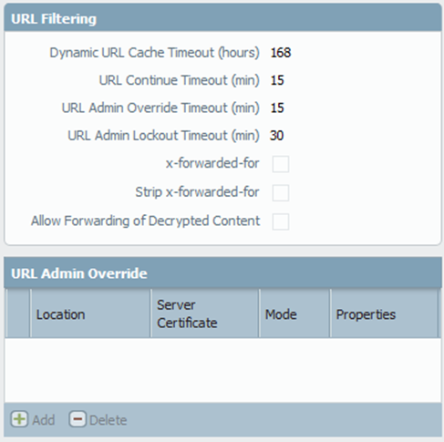
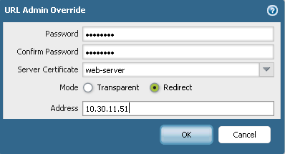
Configuring the URL Admin Override Password
Device > Setup > Content-ID
Notes:
If you have any actions set to Override, you must specify the settings that are used when a page is blocked by the URL filtering profile and the Override action is specified. The override action requires the user enter a password, rather than simply clicking a button like the continue action does. There can be only one URL Admin Override password per firewall.
The Mode setting determines whether the block page is delivered transparently (it appears to originate at the blocked website) or redirected to the user to the specified server. If you choose Redirect, enter the IP address for redirection. The IP address must correspond to a Layer 3 interface on the firewall with an interface management profile assigned with the Response Pages option enabled.
You can customize the behavior of the URL Admin password. The URL Admin Override Timeout sets the lifetime of the override before the user must re-enter the admin override password for URLs in the same category. The URL Admin Lockout Timeout sets the waiting period that a user must wait three unsuccessful override attempts.

Slide 27
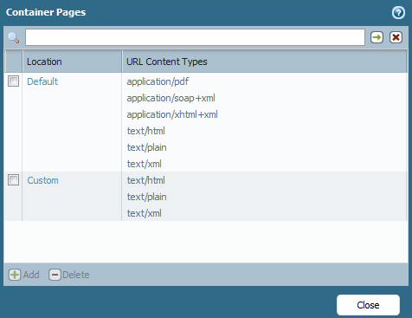
URL Filtering Log Container Page
Device > Setup > Content-ID > Container Page
Notes:
To reduce the amount of information logged, the profile can be configured with the Log container page only option. Container pages specify the types of URLs that the firewall will track or log based on content type, such as text/html, text/xml, text/plain, application (pdf), and image (jpeg).
Adding a new container page overrides the default list of content types. The system-provided default container pages is read-only and cannot be edited. Only one custom container page can exist at a time.

Slide 28
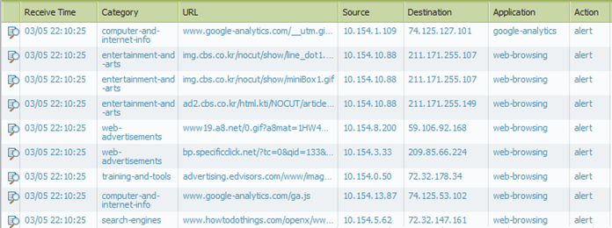
URL Filtering Log
Actions that trigger a log (Alert, Block, Continue, Override, Block-Override) are recorded in the URL Filtering Log
Monitor > Logs > URL Filtering
Notes:
The URL filtering log contains log entries for URLs that have action alert, continue, override, and block. The action taken by the URL Filtering profiles will be listed in the Action column. Actions requiring user interaction will log both the initial blocking action and the successful user interaction. For example, if a user is presented with a Continue block page and then clicks the Continue button, both block-continue and continue entries will be recorded.

Slide 29
URL Filtering Databases
PAN-OS supports two URL Filtering services
BrightCloud | PAN-DB
Relies on a URL database file which is saved to disk and updated daily | Uses a seed database for initial configuration, then the device stays in sync with Cloud servers
Attempts lookups from: Caches Disk database file Cloud servers (if configured) | Attempts lookups from: Caches Cloud servers
Backwards-compatible with PAN-OS 4.x | Only available on PAN-OS 5.0 and higher
Cloud server lookups are optional | Requires an internet connection to the cloud servers to function
Only one lookup service can be active at a time
Notes:
Beginning with PAN-OS 5.0 (used in NS Lab), Palo Alto Networks firewalls support two URL filtering services: PAN-DB and BrightCloud. BrightCloud lookups are available on previous versions of PAN-OS.
The two lookup services are licensed separately and only one can be active on a firewall at a time.

Slide 30
Security Profiles: File Blocking
Notes:
The migration from BrightCloud to PAN-DB is fully automated. Policies and profiles are automatically migrated as part of the activation process. BrightCloud categories will be replaced with PAN-DB categories, without any user interaction. A reboot is not required but an auto-commit will be initiated by the firewall once the activation and migration is complete.
PAN-DB combines similar BrightCloud categories for efficiency and performance purposes. During migration, instances where old categories are replaced by newer categories, the more restrictive action will be applied. For example, consider a URL filtering profile which uses the Religion and Cult and Occult categories set to Alert and Block, respectively. PAN-DB combines these categories into Religion. During migration, the old categories will be replaced with Religion and the action will be set to Block because that was the most restrictive of the original actions.

Slide 31
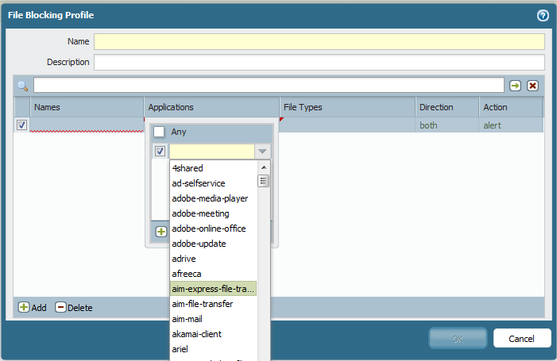
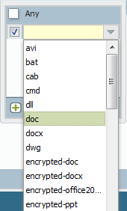

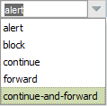
File Blocking Configuration
Driveby Download Protection
Notes:
File Blocking profiles control the flow of a wide range of file types by looking deep within the payload to identify the file type (as opposed to looking only at the file extension) to determine if the transfer of the file is allowed by policy. File blocking by type can be implemented on a per application basis. For example, an organization can use file blocking to enable the use of specific webmail application like Gmail and allow attachments, but block the transfer of specific file types.
The available actions for File Blocking profiles are:
Block – Traffic is blocked, a Block log entry is generated, and a Response page is sent to the user’s browser if the traffic is web-based
Alert – Allow the user to access the file but add an alert to the URL log
Continue – Send a response page requiring the user to click Continue to proceed, log the action
Forward – Send the file to the WildFire cloud for analysis, log the action
Continue and Forward - Send a response page requiring the user to click Continue to proceed and log the action. If the user continues, forward the file to the WildFire cloud and log the action.

Slide 32
Drive-By Download Protection
Traffic matches a File Blocking Profile with Action = Continue
User attempts to download a file through the browser
Website initiates an automatic file download
Continue Response page presented to user
User clicks Continue
User exits the response page
File Download proceeds
File download is cancelled
Log updated
Notes:
Drive-by downloads have become the preferred method for hackers to deliver malware to unsuspecting users. Instead of a user clicking on an attachment in an email, users can become infected via a drive-by download simply by visiting a webpage with an infected image. Often the user and even the owner of the website may be unaware that the site has been compromised. The File Blocking Profile looks within the application session, sees that a download is taking place, and verifies with the user if the file is an approved download.

Slide 33
Summary
Security Profiles
Anti-Virus
Anti-Spyware
Vulnerability
URL Filtering
File Blocking
Security Profile Administration
Zone Protection Profile

